Slide 1
Mini project on Voice Assistance
Voice Assistant Project
Under the guidance of
Dr.Priyadarshini patil
Presented by:
Praneeth.D.H (3PD22CS067)
Aryabal.K (3PD22CS017)

Slide 2
Abstract
Voice Assistant Project
This project involves the development of a Python-based voice assistant designed to recognize user commands and perform simple tasks by leveraging technologies like Natural Language Processing (NLP), speech-to-text, and text-to-speech. Its primary applications include home automation, enhancing accessibility for visually impaired users, and improving everyday productivity. By combining advanced Python libraries with practical use cases, this project addresses real-world challenges in accessibility and automation effectively.

Slide 3
Introduction
Voice Assistant Project
What is a Voice Assistant?
A voice assistant is an AI application capable of understanding and responding to spoken commands.
Popular Examples:
Apple Siri
Amazon Alexa
Google Assistant
Microsoft Cortana
Why Python?
Rich libraries for AI and NLP (e.g., Speech Recognition, pyttsx3, gTTS).
Easy syntax and strong community support.
Importance of Voice Assistants Today:
Accessibility: Assists individuals with disabilities.
Productivity: Streamlines tasks like reminders and messages.
Smart Living: Powers home automation.

Slide 4
Literature Review
Voice Assistant Project
Aspect | Voice Assistants: A Systematic Literature Review | A Literature Survey on Voice Assistance | Voice Assistants and Smart Speakers Adoption Study | AI-Powered Voice Assistants for Education | Future Trends in Voice Technology
Definition | Reviews voice assistants with a focus on ethics, privacy, and NLP integration. | Analyzes Python-based voice assistant implementation and tools. | Explores user adoption, tech advancements, and societal effects. | Discusses the role of voice assistants in personalized learning. | Predicts AI and ML advancements in voice systems.
Problem Addressed | Privacy, accessibility issues. | Complex implementation of tools or library. | Privacy and interaction patterns | Improper solutions. | Resource and offline capabilities in voice technology.
Example | Alexa | Speech Recognition | Google Assistant | Virtual tutors that respond to queries(Scholarly). | Conversational AI(chatgpt).
Limitations | No technical details. | Lacks ethics focus. | Minimal tech depth | Requires high customization for effectiveness. | Low resources.
Focus | Ethical AI and NLP integration. | Python development | User adoption and behaviour | Personalized and inclusive education tools. | Future AI trends and capabilities in voice tech.
Benefits | Promotes ethical AI | Practical guide for developers | User insights | Enhances Personalized learning. | Guides innovation.
Applications | Smart homes, assistive technologies. | Building Python-based voice assistants. | Smart living with AI | Online education and learning. | Global AI systems.

Slide 5
Problem Definition & Motivation
Voice Assistant Project
Problems:
Customization challenges and limited control.
Privacy concerns due to cloud processing.
Reliance on internet connectivity.
Accessibility issues for visually impaired users like manual setup.
Motivation:
Enable offline operation for better privacy.
Create a customizable Python-based voice assistant.

Slide 6
Objectives
Voice Assistant Project
Main Goals:
Build a Python-based voice assistant using open-source tools/library.
Incorporate speech-to-text and text-to-speech capabilities.
Additional Features:
Execute commands like web searching and file management.
Provide offline functionality where possible.
Long-term Vision:
Enhance connectivity with smart home devices.

Slide 7
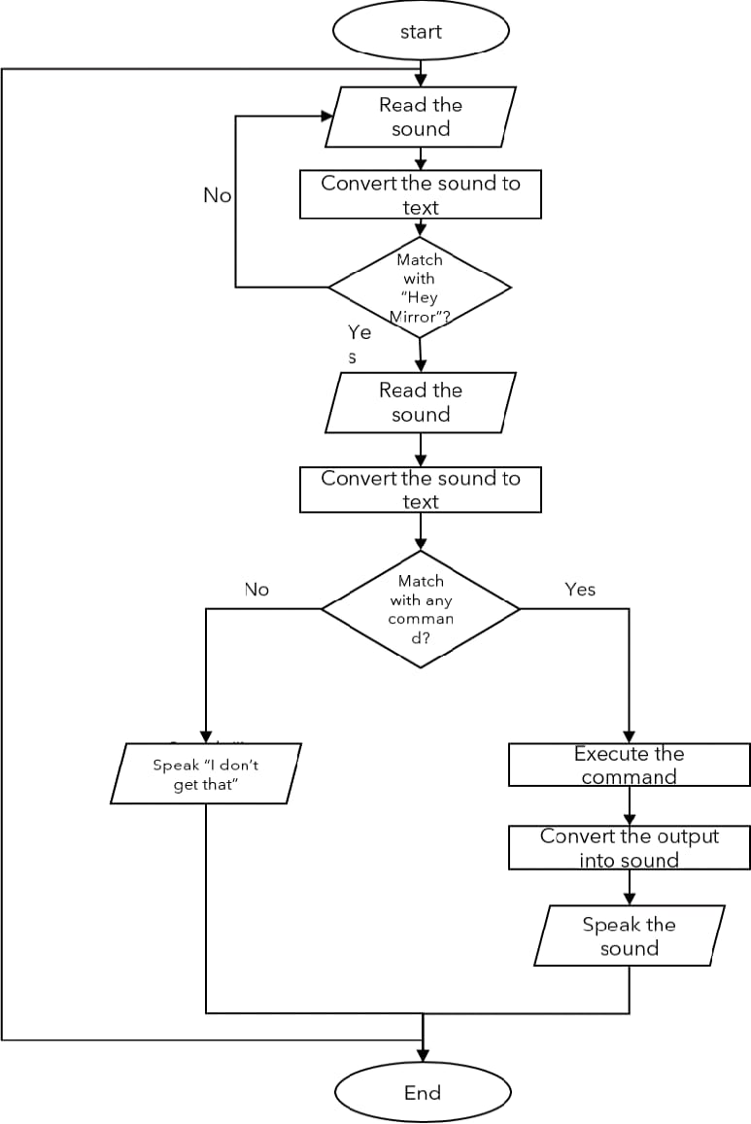
Proposed Methodology
Voice Assistant Project
Architecture:
- Input: Voice command captured using a
microphone.
- Processing: Convert speech to text, analyze
with Natural Language processing(NLP).
-Output: Execute tasks or provide
text-to-speech feedback.
Workflow:
- Install Dependencies and libraries
(e.g., Speech Recognition, pyttsx3).
- Create a Command Structure for task
recognition.
- Test in different environments to ensure
accuracy.
Flow chart of how the voice assistant works

Slide 8
Applications
Voice Assistant Project
Real-life Use Cases:
Personal Productivity: Scheduling tasks and setting reminders.
Accessibility: Assisting visually impaired individuals.
Home Automation: Controlling smart devices.
Healthcare Assistance: Monitoring patient health and providing reminders for medication.
Education: Offering personalized learning and tutoring assistance

Slide 9
Conclusion
Voice Assistant Project
Python offers a versatile platform for creating voice assistants. This project focuses on enhancing accessibility and productivity while addressing privacy concerns. Future scope includes integrating AI-driven sentiment analysis and supporting multiple languages.

Slide 10
Reference
Voice Assistant Project
1. Pooja Darda, R. M. Chitnis, "Voice Assistants: A Systematic Literature Review," IEEE Xplore, 2020. Link to IEEE Xplore
2. Bhoomika Chowdary, A. N., Lavanyan, M., & Darshan, S. (2021). A Literature Survey on Voice Assistance and Development Using Python. IJRASET. https://www.irjet.net/archives/V7/i9/IRJET-V7I9678.pdf
3. Kaushal, S. M., & Mishra, M. (2022). AI-Powered Voice Assistants: Transforming the Educational Landscape. ResearchGate. https://www.researchgate.net/publication/359216654_AI-Powered_Voice_Assistants_for_Education
4. “AI-Powered Voice Assistants: Transforming the Educational Landscape,” ResearchGate, 2022.
https://www.researchgate.net/publication/359216654_AI-Powered_Voice_Assistants_for_Education
5. “The Future of Voice Technology: AI and Machine Learning Advances,” TechCrunch, 2023.
https://techcrunch.com/2023/02/13/the-future-of-voice-technology-ai-and-ml/

Slide 11
THANK YOU

